Slide 1

CST363 Database
A CSUMB Extended Education Online course
Spring 2019A
David Wisneski

Slide 2
Things to know about this course
Teaching Assistant: Nikola Petkov
Textbook: “murach’s MySQL” by Joel Murach, 2nd Edition
Software needed for course
MySQL (including MySQL Workbench, sample databases)
Source code from Murach textbook (murach website, also posted on iLearn)
Python Version 3
Also need to do pip install mysql-connector-python
Schedule of topics
To contact me
Use the iLearn course Ask Instructor Forum, office hours, email
For this orientation
Download files: orientation.sql, orientation-selects.sql

Slide 3
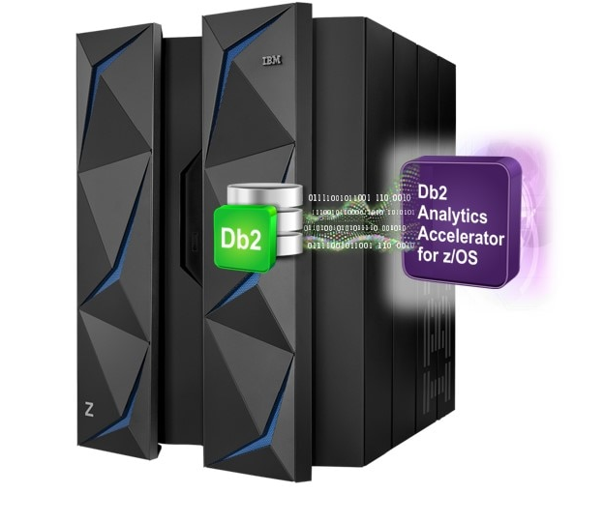

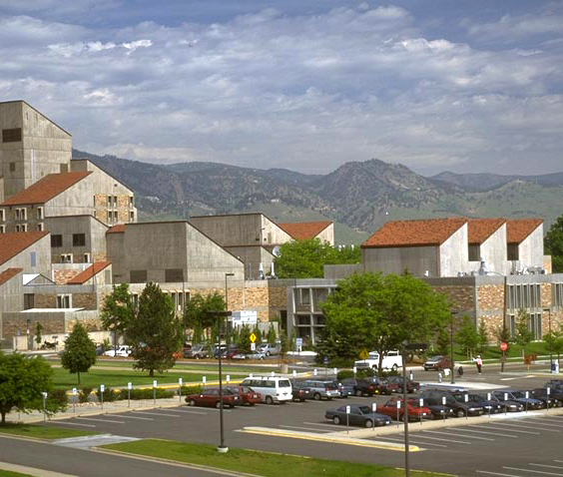
About your instructor
Education: University of Colorado, Boulder
Applied Math & Computer Science
Interned at IBM in Longmont, Colorado
APL & Manufacturing Control Systems
IBM 1978-2010
Database Administration,
Relational database (DB2) development,
Java J2EE server (WebSphere) development

Slide 4

APL – A Programming Language
From repl.it
Example APL program that computes the 9th Fibonacci number. Which of course is 34.

Slide 5
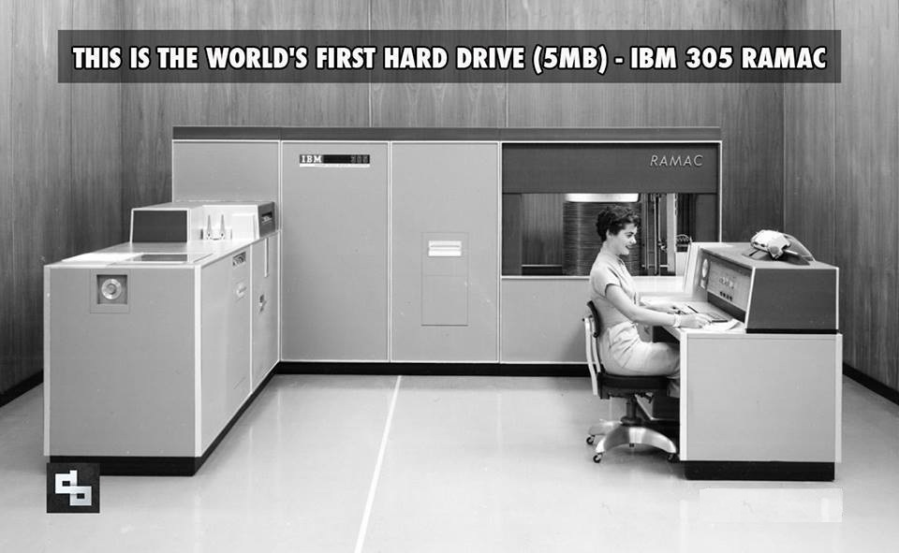
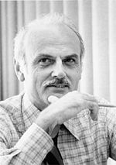
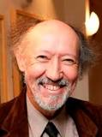
A Short History of Database
1956 First commercial moveable head disk drive
Leads to online processing systems
Capable of efficient lookup, update and sharing the files. But complicated.
First generation DBMS - make the programs easier to write and independent of details of the file and index system
Relational database
Created in 1969 by Dr. Edgar Codd (1923-2003)
Intended to simplify and give easier access to data
Normalization of data design
SQL (Structured Query Language)
select, insert, delete and update for data manipulation
Create and drop tables, grant and revoke access
Industry standard from 1986 to today
1990s
Internet applications, html, web applications
Traditional dbms couldn’t scale to internet size. Google, Yahoo, Facebook create alternatives
Object database for C++ and object oriented languages
Data for which rows and columns is not a good fit: Documents, XML
Special databases for data mining (column store versus row store)
NoSQL movement: No SQL or Not Only SQL.
One size does not fit everyone.
What the NoSQLs gain in performance or flexibility, they usually sacrifice in transaction integrity, search capability
Ed Codd
Chris Date

Slide 6
Mathematical Prerequisites
Based on mathematical models of sets, cartesian products, relations and predicates
Example: Sets A = { 1, 2, 3} B={Tom, Ana}
Cartesian Product
All possible combinations of an element from A with an element from B
A X B = { (1,Tom), (2,Tom), (3,Tom), (1,Ana), (2, Ana), (3, Ana) }
Each of the elements in A X B is called an order pair or a “tuple”
A relation is a subset of the Cartesian Product
{ (1,Tom), (2, Ana) } is one possible relation
Predicate: P(name) = { (a,b) in A X B where b==name }
P(Ana) returns the set { (2, Ana) } that has only one element
Predicate: Q(n) = { (a,b) in A X B where a >= n }
Q(1) returns the set { (1,Tom), (2,Ana) }

Slide 7
Relational DB model
Relations are stored as tables
Table columns have a declared name and datatype
All values in the column must conform to the datatype
Table has a primary key
One or more columns that uniquely identify a row
Is optional but almost all tables do have a primary key
Can be auto-generated by the DBMS
Null values
A special value different from 0 or empty string.
Means the value is unknown or not applicable to this entity.
Must consider how it works with predicates: = != > < Max, Min, AVG
There are special predicates: “is null” and “is not null” to search for null values

Slide 8
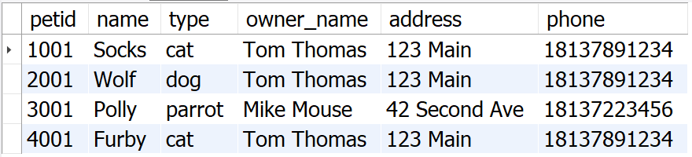
Query Structure
Set Operation(s)
Join
Union
Predicates
Filter rows
Where clause
Relation(s)
From clause
Projection: output columns
Select clause
Optional grouping
and sorting
Important note: a query takes in one or more relation(s) and output is a relation. We can chain queries together with the output of one query as input to another !

Slide 9
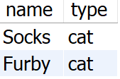
Query Structure
SELECT name, type
FROM pet
WHERE type=‘cat’

Slide 10
Design and Normalization
Avoid unnecessary duplication of data
Leads to inconsistent data
Increase size of database (decreases performance)
A row should represent a single entity
Identify with a primary key (natural or artificial)
Example of unnormalized design. What happens if owner’s phone changes? How to store data on an owner who has no pets?

Slide 11
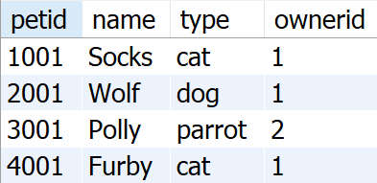
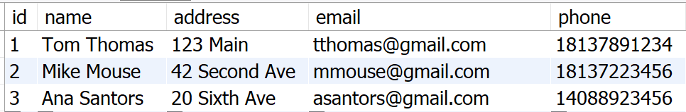
Design and Normalization
Unnormalized
design
Normalized
design
Primary key column: ownerid
Primary key column: petid
Notes:
To relate the tables: the primary key ownerid is stored as column in pet table as ownerid.
This is called a foreign key.
This is example of 1:Many relationship from Owner to Pet. An Owner has may several (0 or more) pets. Each pet has only one owner.

Slide 12
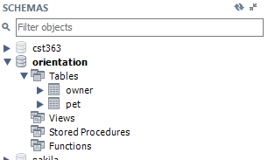
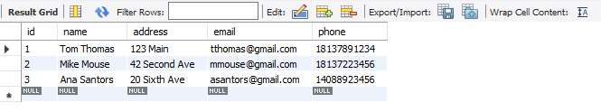
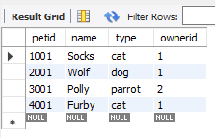
Setup example tables
Using MySQL Workbench: File → Open SQL Script and navigate to “orientation.sql”
Run this script which creates the “pets” and “owners” tables
Display a table by clicking on the table icon next to table name

Slide 13
Select statement examples
select all columns and rows
select * returns all column in order defined by the table
SELECT * FROM owner;
select subset of columns (projection)
Rename columns and specify column order
SELECT id as StudentID, name, address FROM owner;
select subset of rows
SELECT * FROM pets WHERE type='cat’;
specify order of result
Rows in a table have no defined order. If you want result to be in order, specify ORDER BY clause.
SELECT id, name, address FROM owner ORDER BY name;

Slide 14
Select statement examples
Order by last name
Use SQL functions to separate first and last names
(see chapter 9 "How to work with string data“
Or table should have firstname and lastname columns
SELECT id,
substring_index(name,' ',1) as firstname,
substring_index(name, ' ', -1) as lastname,
address
FROM owner
ORDER BY lastname;

Slide 15
Join examples
Cartesian product. Also called inner join or just join. Usually not useful.
All rows from pet table are joined with all rows from owner table.
SELECT * FROM pet, owner;
We want pets to be related to their owner.
That is the ownerid column in pet should equal id column in owner
SELECT * FROM pet, owner WHERE ownerid = id;
name column is ambiguous because both tables have name column. Qualify name with table name.
SELECT * FROM pet, owner WHERE ownerid=id AND pet.name='Socks’;
another way to do it using table aliases
SELECT * from pet p, owner o where p.ownerid=o.id and p.name='Socks’;

Slide 16
Outer Join example
A report of pets and their owners using inner join, an owner with no pets will not appear. Only matching rows appear.
SQL outer join to the rescue
The join predicate is in an ON clause
Row from owner table with no matching row from pet table will appear in the result with NULL values for all pet columns
SELECT *
FROM owner o LEFT OUTER JOIN pet p ON p.ownerid=o.id;

Slide 17
Weeks 0 and 1
Week 0
Install MySQL (this should include MySQL Workbench and MySQL samples)
Install Python Version 3
Then do pip install mysql-connector-python
Read chapters 1 and 2 in murach textbook
concepts and using MySQL Workbench.
Quiz 0 - Deadline Tuesday Jan 8
Week 1
Read and do exercises in chapters 3, 4 and 5
Part 2 of homework 1 you will write a program in Python in the form of a CGI script (a web app) and using SQL to read and modify a database.
Watch for video lectures (soon to published on iLearn) about homework 1.
Quiz 1 - Deadline Tuesday Jan 15.

